Slide 1
Angular Components: The Building Blocks of the UI

Slide 2
What is a Component?
The fundamental building block of an Angular application.
Encapsulates a piece of the UI (User Interface) and its logic.
Everything we see on an Angular page is a component.
Like Lego bricks, we snap them together to build complex structures.

Slide 3
Component structure
Every component consists four main parts:
TypeScript Class: Handles data and logic (the "Brain").
HTML Template: Defines what the user sees (the "Body").
CSS Styles: Defines how it looks (the "Skin").
Metadata: Linked via the @Component decorator to tell Angular how to process the class.

Slide 4
Component Files
Angular CLI creates 4 files:
hello.component.ts → logic
hello.component.html → template
hello.component.css → styles
hello.component.spec.ts → tests
Command:

Slide 5
Data Binding Types
Angular supports:
Interpolation → {{ }}
Property binding → [value]
Event binding → (click)
Two-way binding → [(ngModel)]
Example:
<input [(ngModel)]="name">

Slide 6
The @Component Decorator
Selector: The custom HTML tag used to call the component (e.g., <app-user-profile>)
templateUrl / template: Path to the HTML file or an inline string.
styleUrls / styles: Path(s) to the CSS file or inline styles.
standalone: (Modern Angular) Set to true to use the component without an NgModule.

Slide 7
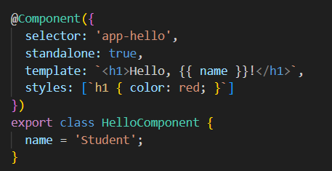
The @Component Decorator

Slide 8
Component Lifecycle hooks
ngOnChanges(): Responds when data-bound input properties change.
ngOnInit(): Initialize data here (better than the constructor).
ngAfterViewInit(): When the component's view is fully ready.
ngOnDestroy(): Cleanup (unsubscribe from streams, etc.).

Slide 9
Data Communication (Input/Output)
How do components talk to each other?
Parent to Child (@Input): Passing data down using property binding.
Example: <app-child [userData]="parentData"></app-child>
Child to Parent (@Output): Sending data up using EventEmitters.
Example: <app-child (save)="onSave($event)"></app-child>

Slide 10
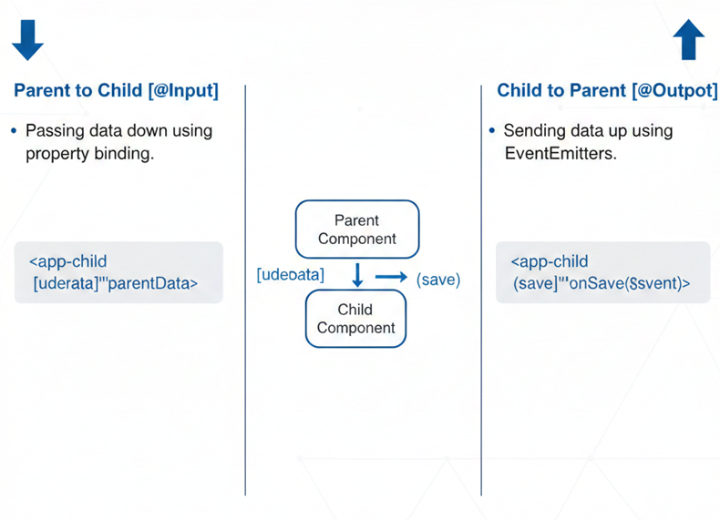
Data Communication (Input/Output)

Slide 11
Best Practices
✔ Keep components small ✔ Single responsibility ✔ Avoid business logic in templates ✔ Use services for shared data ✔ Follow Angular style guide

Slide 12
Task!
Build a small component:
Create component: ng g c user-card
Add:
Input fields
Click events
Lifecycle hook
Parent communication

